Slide 1
UML Diagrams

Slide 2
Lesson 1: Use Case Diagram

Slide 3
Objective
In this lesson, the following points will be studied:
Introduction to use case diagrams, its symbols and the meaning and usage of each symbol.
Use case relationships(Association, Include, Extend, Generalization
A comparison between the previous relations.
Use case contents and Use case modeling core elements and core relationships
Real life examples will be discussed at the end of lesson three.
University Course Registration System case study is discussed

Slide 4
Topic 1: Introduction to Use Case Diagram

Slide 5
Requirements Document
1. Purpose and scope
2. The terms used / Glossary
3. The use cases
4. The technology to be used
5. Other various requirements
6. Human backup, legal, political,
organizational issues

Slide 6
Introduction
Use case diagrams:
Jacobsen’s contribution to UML
are done in an early phase of a software development project.
express how it should be possible to use the final system. not trying to specify how the system shall solve the tasks.
focus on specifying how an external user interacts with the system.
are a good way to express the functional requirements of a software system.
provide a visual way to document user goals and explore possible functionality
A ‘use case’ is a significant type of activity performed, using the system, by one or more actors
captures and manages functional requirements in a use case model.
hey are intuitive and easy to understand so they can be used in negotiations with non programmers.
The granularity of a use case is typically larger than a single operation, but smaller than systems.
By writing use cases for a system, developers can make sure that no particular kind of user or potential purpose for the system is overlooked Though use cases are often associated with object oriented analysis, use cases are not object oriented They could be used to help capture functional requirements for any type of system

Slide 7
Use case
Captures a contract between the stakeholders of a system about its behavior.
Describes the system’s behavior under various conditions as it responds to a request " from a stakeholder, the primary actor.
The primary actor initiates an interaction with the system to accomplish some goal.
The system responds, protecting the interests of all the stakeholders.

Slide 8
Purpose
Describes business’ work process,
Focus discussion about up coming software system requirements, " not a requirements description substitute
Functional requirements for a system
Document the design of the system

Slide 9
Requirements and Use Cases
! They can represent the functional (behavioral) requirements
" If properly written
They miss
" External interfaces
" Data formats
" Business rules

Slide 10
Definition
A use case describes a goal-oriented
set of interactions between external
actors and the system under
consideration.

Slide 11
Definition of Use Case
The classic definition of Use case comes from Ivar Jacobson’s ‘Object-Oriented Software Engineering’ (OOSE) which states:
“A Use Case is a sequence of transactions in a system
whose task is to yield a measurable value to an individual
actor of the system.”
A use case is “a sequence of transactions through the system, that is, an instance”
An actor is “a role that someone or something in the environment can play in relation to the business.

Slide 12
Use Case Diagram
The use case diagram is an easy way for an analyst to discuss a process with a subject matter expert (SME).
Use case diagrams are created to visualize the relationships between actors and use cases
A use case diagram summarizes all the major use cases for a system
Components of use case diagram :
List of Use Cases
Actors
External Systems (if any)
System Boundary

Slide 13
Use Case Diagram Symbols

Slide 14
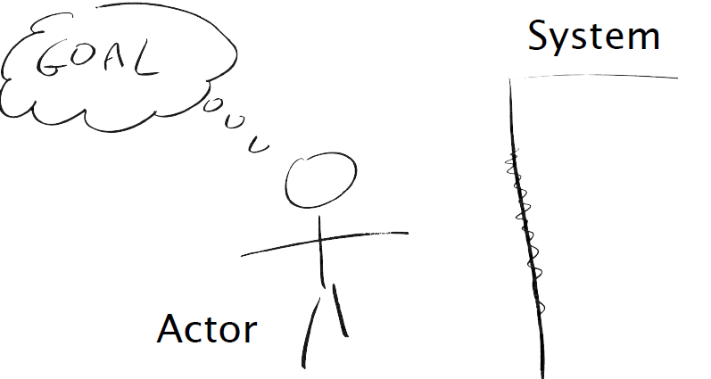
Key elements

Slide 15
Key elements
The actor involved
" type of user that interacts with the system
The system being used
" treated as a black-box
The functional goal that the actor
achieves using the system
" the reason for using the system

Slide 16
Actors
Actors:
are types of users of the system – the role of someone who uses the system
must interact directly with the system. Interaction could be through any mechanism – keyboard, mouse, touch screen, card reader, etc.
It is role a user plays with respect to system.
are not part of the system they represent anyone or anything that must interact with the system.
carry out use cases and a single actor may perform more than one use cases.
are determined by observing the direct uses of the system, Those are responsible for its use and maintain as well as other systems that interact with the developed system.
UML notation for actor is stickman, shown below.
Customer
Manager
Cashier

Slide 17
ACTOR (Cont)
An actor may
- input information to the system.
- receive information from the system.
- input to and out from the system.

Slide 18
Finding Actors: Useful Questions
The following questions may be used to help identify the actors for a system
Who or what will use the main functionality of the system?
Who will supply the system with this information, use this information and remove this information?
Who or what will use output from this system?
Who will need support from the system to do their work?
Are there any other software systems with which this one needs to interact
Are there any hardware devices used or controlled by this system?
Who is interested in a certain requirement?
Where in the organisation is the system used?
Who will user this particular function in the system?
Who will support and maintain the system?

Slide 19
USE CASE
A use case:
is a description of a set of sequences of actions, including variants, that a system performs to yield an observable result of value to an actor
is a sequence of related transactions performed by an actor and the system in dialogue.
is dialogue between an actor and the system.
a description of what the system must do, not of how it should do it.
describes a process. (But a use-case diagram is Not a process description.)
must have a name that distinguishes it from other use cases
It is a snapshot of one aspect of system.
model a dialog between actor and system.
typically represents a major piece of functionality that is complete from beginning to end.
Mostly, are generated in initial phase, but you find some more as you proceed.
may be small or large. It captures a broad view of a primary functionality of the system in a manner that can be easily grasped by non technical user.

Slide 20
USE CASE (Cont.)
Use cases are represented by ovals
Examples:
Open new account
Withdrawal of cash from ATM

Slide 21
Finding Use Case: Useful Questions
The following questions may be used to help identify the use cases for a system
What functions will the actor want from the system?
What use cases will create, store, change, remove, or read this information?
Will any actor need to inform the system about sudden, external changes?
Does any actor need to be informed about certain occurrences of the system?
What use case will support and maintain the use case?
Can all functional requirements be performed by the use case?

Slide 22
External Systems
External systems are any non-human (generally computerized) actor which your system needs to perform one or more use cases
Are systems you don’t control, and are outside the scope of your system development

Slide 23
External Systems
Could include systems owned by vendors
E.g. a service to maintain your online catalog
Could be a custom legacy system which isn’t being replaced
E.g. an existing human resource system, or accounting system
Can be a Timer, to initiate automatically repeating use cases

Slide 24
System Boundary
The use case diagram includes a box to show the boundaries of the system
Actors are not within the boundary
External systems are not within the boundary
Box is labeled with your system’s name
The system boundary is shown on the top-level diagram (context level).
It helps to identify what is external verses internal, and what the responsibilities of the system are.

Slide 25
Example 1: Use cases diagram for a supermarket system
System boundary
Buy Items
Return purchased item
Customer
Cashier
Notes:
In the shown example:
There are two actors:
Customer and Cashier who both can perform two functionalities “Buy Item” and “Return Purchased Item”

Slide 26
Example 2: Use Case Diagram for Elevator Control System
Request
Elevator
Select
Destination
Elevator
User
Arrival
Sensor
Elevator Control System actors and use cases
Notes:
In the shown example:
There are two actors:
Elevator User and Arrival Sensor who both can perform two functionalities “Request Elevator” and “Select destination”

Slide 27
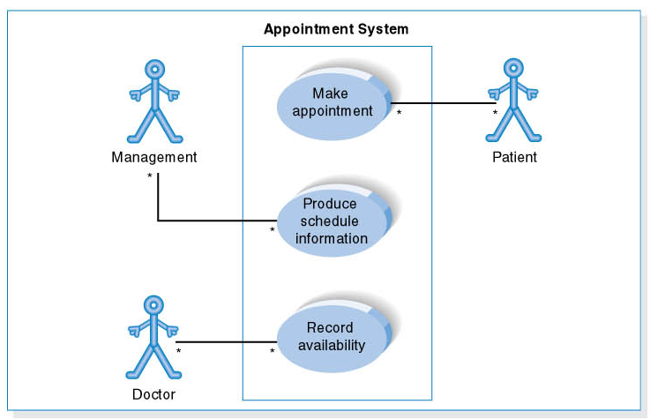
Example 3: Use Case Diagram for Appointment System
Notes:
In the shown example:
There are three actors:
Management --- which can “Produce Schedule information”
Doctor --- who can “Record availability”
Patient --- who can “make an appointment”

Slide 28
Topic 2: Use Case Relationships

Slide 29
Use Case Relationships
Can organize use cases by specifying relationships among them.
Generalization
Include
Extend
Association:
Notes:
19

Slide 30
Use Case Relationships: Association
Communication between an actor and a use case; is often referred as “communicates”
Represented by a solid line.

Slide 31
Use Case Relationships: include
Include relationships, between two Use Cases, model that the functionality A is used in the context of the functionality B, being one of its phases.
Typically, include relationships are used to extract fragments of use cases that are duplicated in multiple use cases.
If a use case includes multiple others, they are both required in the including use case.
It can be also indicated asuses(e.g., in the following example, both password check and fingerprint scan are phases of the identity verification).

Slide 32
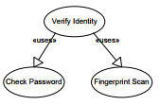
Use Case Relationships: include

Slide 33
Use Case Relationships: include
Includes Dependency: Defines how one use case can invoke behavior defined by another use case
Include: a dotted line labeled <<include>> beginning at base use case and ending with an arrows pointing to the include use case. The include relationship occurs when a chunk of behavior is similar across more than one use case. Use “include” in stead of copying the description of that behavior.
Representation: <<include>>
Base
Use Case
<<include>>
Included
Use Case

Slide 34
Use Case Relationships
Include
Base use case explicitly incorporates the behavior of another use case at a location specified in the base
Use an include relationship to avoid describing the same flow of events several times
by putting the common behavior in a use case of its own

Slide 35
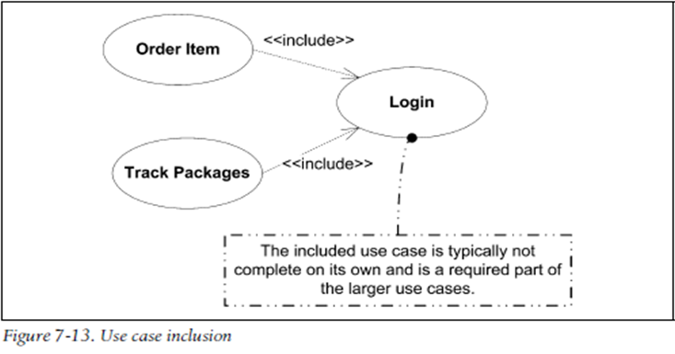
Example : Include relation
Notes:
Figure shows an example of use case inclusion
Order Item and Track Packages use cases includes Login use case. This means that the execution of Order Item and Track Packages functionality won’t terminate except when Login use case finishes its execution

Slide 36
Use Case Relationships: Extend
Extends dependency: defines a use-case that is a variation of another, usually for handling an abnormal situation
means that the extending use case adds new interaction steps to the base use case atlocations specified in the extending use case.
Extend: a dotted line labeled <<extend>> with an arrow toward the base case. The extending use case may add behavior to the base use case. The base class declares “extension points”.
Representation
<<extend>>
Base
Use Case
<<extend>>
Extending
Use Case

Slide 37
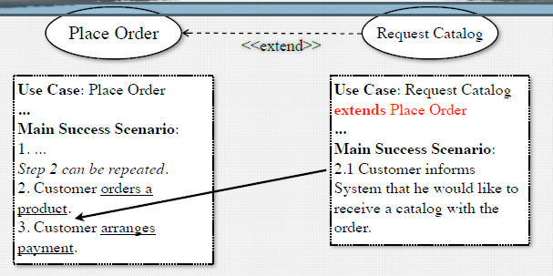
Use Case Relationships: Extend

Slide 38
Use Case Relationships: Extend
Extend
An extend relationship between use cases means that the base use case implicitly incorporates the behavior of another use case at a location specified indirectly by the extending use case
Use an extend relationship to model the part of a use case the user may see as optional system behavior
Behavior that is run only under certain conditions, such as triggering an alarm

Slide 39
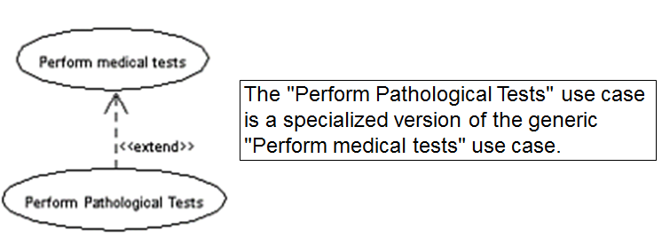
Example: Extend relation
Notes:
Figure shows an example of use case extend relation
Perform medical tests use case extends Perform Pathological tests use case. This means that the Perform Pathological tests use case fire under certain conditions.

Slide 40
Use Case relationships: Generalization
Generalization: Defines one use case as a generalization of another. Replaces generic functionality with alternate implementation
Generalization: relationship between one general use case and one specific use case.
Represented by a line with a triangular arrow head toward the parent use case.
Super
Use Case
generalization
Sub
Use Case

Slide 41
Use Case relationships: Generalization
Generalization
Child use case inherits the behavior and meaning of the parent use case
Child use case may add to or override the behavior of its parent
Child use case may be substituted any place the parent use case appears

Slide 42
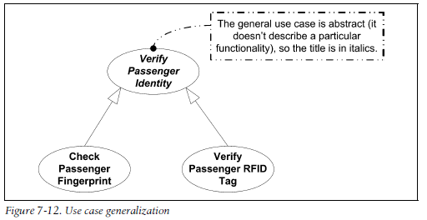
Example: Generalization relation
Notes:
Figure shows an example of use case generalization relation
Check Passenger Fingerprint and Verify Passenger RFID Tag use cases are specialized use cases of Verify Passenger Identity use case

Slide 43
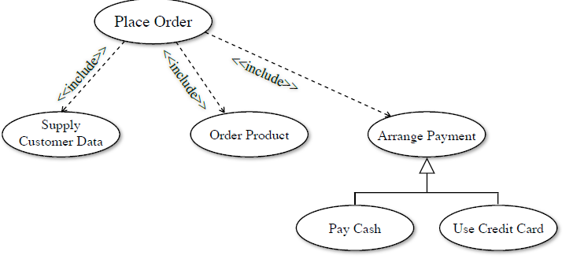

Slide 44
Extends vs. Includes vs. Generalization
Extends, includes, and generalization may appear similar, but differ in intent
Extend dependencies model variations from normal workflows
Specializations are refinements of a general use cases
“Include” uses case (or sub-use cases), unlike specializations, can represent different goals or processes
Include dependencies are a form of aggregation
The actors for a general use case are also actors for the use cases that specialize it
Often there are no actors for sub-use cases

Slide 45
Organizing Use Cases Example 1:
Generalization, Extend, Include/Use, packages
does a bit more or deals with a special situation
extension point
extension
Place order
Extension points:
set priority
<<extend>>
(set priority)
Place rush order
extension use case
<<include>>
inclusion use case
inclusion
Check password
Validate user
Track order
generalization
<<include>>
child use case
common to multiple use cases;
Often no actor may be associated
with a ‘used’ use case
Retinal scan
base use case
Track Order - Obtain and verify the order number; For each part in the order, query its status, then report back to the user.
Place Order - Collect the user’s order items. (set priority). Submit the order for processing.

Slide 46
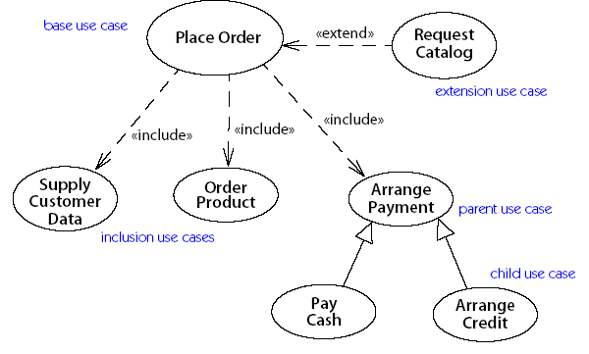
Example 2:

Slide 47
Topic 3: Use Case description contents

Slide 48
Use Case Description Contents 1
Use case name and number
Actors
Stakeholders and their needs
Preconditions—A precondition is an assertion that must be true when an activity or operation begins.
Not checked by the use case
Postconditions—A postcondition is an assertion of what must be true when an activity or operation ends.
Must satisfy stakeholder needs

Slide 49
Use Case Description Contents 2
Trigger—A trigger is an event that causes a use case to begin.
May be the first step in the use case
Basic flow
An action flow: a list of steps
Documents a standard, successful interaction
Begins at the trigger, continues until the use case ends
Extensions
Alternative action flows
May begin and end anywhere
Extensions may have extensions

Slide 50
Use Case Modeling : Core Elements

Slide 51
Use Case Modeling : Core Relationships
<<extend>>

Slide 52
Use Case Modeling : Core Relationships
<<include>>

Slide 53
Topic 4: Examples

Slide 54
Example: Point of Sale Terminal (POST)
• Computerized system to record sales and handle payments
• Typically used in a retail store
• Includes HW components, such as computer and bar code scanner
• Software to run the system
• Goals of system:
– Increase checkout automation
– fast and accurate sales analysis
– automatic inventory control

Slide 55
Example: Point of Sale Terminal (POST)
Notes:
In POST;
Cashier and Customer can Buy Item and Refund a purchased item. Only Cashier can Login to the system

Slide 56
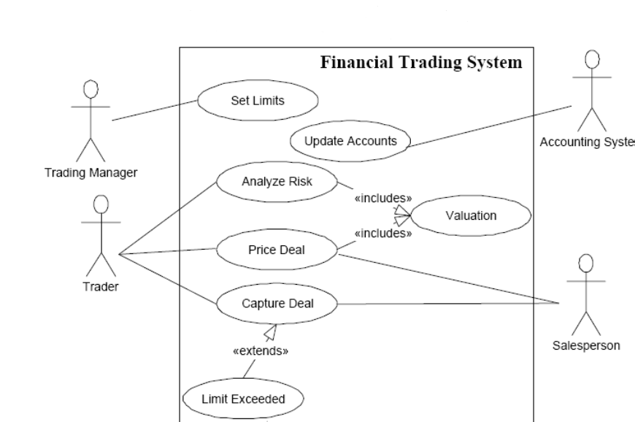
Example: Financial Trading system
Notes:
In the Financial Trading system;
Trading Manager can set limits
Accounting systems can update accounts
Trader and Salesperson can Price Deal and Capture Deal which extends Limit Exceeded.
Trader can also Analyze Risk. Both Analyze Risk and Price Deal includes Valuation use case while execution

Slide 57
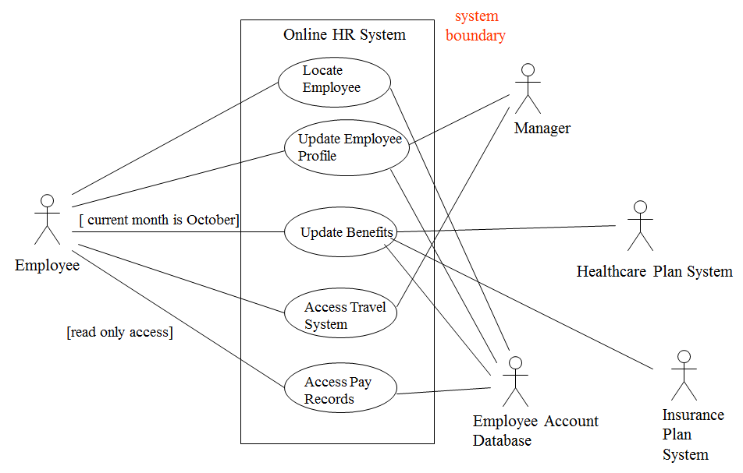
Example: Online Human Resources (HR) System
Notes:
In Online HR system:
Employee and Employee Account Database can Locate Employee, Update Employee Profile, Update Benefits and Access Pay Records. Employee can also Access Travel System with the Manager. Manager can also Update Employee Profile.
Healthcare Plan system and Insurance Plan system can Update Benefits.

Slide 58
Example: Home Heating Use-Cases
Use case: Power Up, Power Down, Change Temp.
Actors: Home Owner (initiator)
Type: Primary and essential
Description: The Home Owner turns the power on. Each room is temperature checked. If a room is below the the desired temperature the valve for the room is opened, the water pump started, the fuel valve opened, and the burner ignited. If the temperature in all rooms is above the desired temperature, no actions are taken.
Cross Ref.: Requirements XX, YY, and ZZ
Use-Cases: None

Slide 59
Home Heating Use-Case Diagram

Slide 60
HACS
• Homework assignment and collection are an integral part of any
educational system. Today, this task is performed manually.
What we want the homework assignment distribution and
collection system (HACS for short) to do is to automate this
process.
• HACS will be used by the instructor to distribute the homework
assignments, review the students’ solutions, distribute
suggested solution, and distribute student grades on each
assignment.
• HACS shall also help the students by automatically distributing
the assignments to the students, provide a facility where the
students can submit their solutions, remind the students when
an assignment is almost due, remind the students when an
assignment is overdue.

Slide 61
HACS

Slide 62
Example:
A user placing an order with a sales company might follow these steps :
Browse catalog and select items.
Call sales representative.
Supply shipping information.
Supply payment information.
Receive conformation number from salesperson.

Slide 63
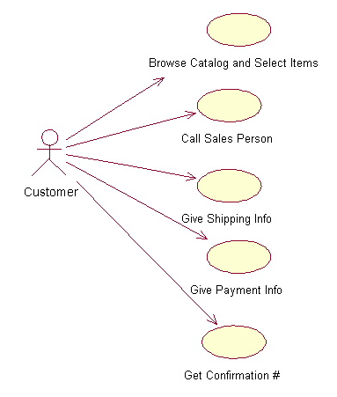
Use-Case Diagrams
The salesperson could also be included in this use case diagram because the salesperson is also interacting with the ordering system.
Notes:
From this simple diagram the requirements of the ordering system can easily be derived. The system will need to be able to perform actions for all of the use cases listed. As the project progresses other use cases might appear. The customer might have a need to add an item to an order that has already been placed. This diagram can easily be expanded until a complete description of the ordering system is derived capturing all of the requirements that the system will need to perform.

Slide 64
Topic 5: Case Study
University Course Registration System

Slide 65
university Course Registration System(UCR)
The EELU University registration system with the following specification:
The Registrar sets up the curriculum for a semester
One course may have multiple course offerings
At the beginning of each semester, students request a course catalogue containing a list of course offerings needed for the semester.
The new system will allow students to select four course offerings for the coming semester
Students select 4 primary courses and 2 electives courses
Once a student registers for a semester, the billing system is notified so the student may be billed for the semester
Students may use the system to add/drop courses for a period of time after registration
Professors must be able to access the online system to indicate which courses they will be teaching, and to see which students signed up for their course offerings.
Users of the registration system are assigned passwords which are used at logon validation
Copyright © 1997 by Rational Software Corporation
Notes:
13

Slide 66
UCR— ACTORS AND FUNCTIONAL REQUIREMENTS
A person who is registered to take classes at the university.
.
An external system responsible for billing students.
A person who is part of the teaching staff of the university..
Student
Billing System
Professor

Slide 67
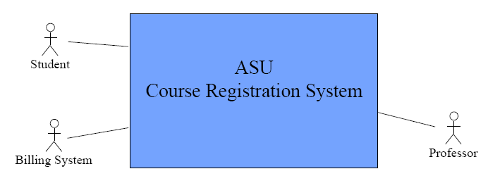
USE-CASE MODEL

Slide 68
ASU Course Registration System
Use-case Model
Use-case

Slide 69
UCR — ACTORS AND FUNCTIONAL REQUIREMENTS
A person who is responsible for maintaining the curriculum information inclusive of students, professors and courses. The Registrar uses the Registration System to prepare the course catalogue for the coming semester.
A person who is registered to take classes at the university. A student uses the Registration System to register for courses in the current or a future semester.
An external system responsible for billing students. Once a student successfully registers for a semester, the billing system is notified with billing information from the Registration System.
A person who is part of the teaching staff of the university. A professor uses the Registration System to make choices on the courses to teach and to request course enrolment lists.
Registrar
Student
Billing System
Professor

Slide 70
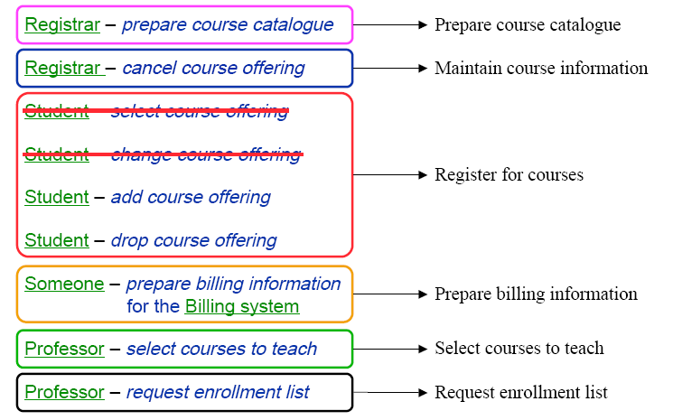
ASU:USE CASES — FUNCTIONALIITY ANALYSIS & GROUPING

Slide 71
ASU — USE CASES
Maintain student information
Maintain professor information
Registrar
Maintain course information
Prepare course catalogue
Student
Register for courses
Select courses to teach
Time
Professor
Prepare billing information
Request enrollment list
Billing System
«communication» association (implicit)

Slide 72
Diagrams in UML
The UTD wants to computerize its registration system
The Registrar sets up the curriculum for a semester
Students select 3 core courses and 2 electives
Once a student registers for a semester, the billing system is
notified so the student may be billed for the semester
Students may use the system to add/drop courses
for a period of time after registration
Professors use the system to set their preferred course offerings
and receive their course offering rosters after students register
Users of the registration system are assigned passwords
which are used at logon validation

Slide 73
Diagrams in UML – Actors in Use Case Diagram
An actor is someone or some thing that must interact with the system under development
The UTD wants to computerize its registration system
The Registrar sets up the curriculum for a semester
Students select 3 core courses and 2 electives
Once a student registers for a semester, the billing system is
notified so the student may be billed for the semester
Students may use the system to add/drop courses
for a period of time after registration
Professors use the system to set their preferred course offerings
and receive their course offering rosters after students register
Users of the registration system are assigned passwords
which are used at logon validation
Registrar
Student
Billing System
Professor

Slide 74
Diagrams in UML – Use Cases in Use Case Diagram
A use case is a sequence of interactions between an actor and the system
Maintain
Curriculum
The UTD wants to computerize its registration system
The Registrar sets up the curriculum for a semester
Students select 3 core courses and 2 electives
Once a student registers for a semester, the billing system is
notified so the student may be billed for the semester
Students may use the system to add/drop courses
for a period of time after registration
Professors use the system to set their preferred course offerings
and receive their course offering rosters after students register
Users of the registration system are assigned passwords
which are used at logon validation
Register
for Courses
Registrar
Student
Billing System
Request
Course Roster
Set
Course Offerings
Professor

Slide 75
Diagrams in UML – Use Case Diagram
Use case diagrams depict the relationships between actors and use cases
UTD Registration System
system boundary
Maintain
Curriculum
Registrar
Register
for Courses
Billing System
Student
Manage
Seminar
Request
Course Roster
Professor
Set
Course Offerings

Slide 76
Summary
In this lesson, the following points were covered:
Introduction to use case diagrams, its symbols and the meaning and usage of each symbol.
Use case relationships(Association, Include, Extend, Generalization
A comparison between the previous relations.
Use case contents and Use case modeling core elements and core relationships
Real life examples and University Course Registration System case study were discussed

Slide 77
Quiz

Slide 78
Activity

